Slide 1

Forests 2020:
Cloud Masking
Presented by
IPB

Slide 2
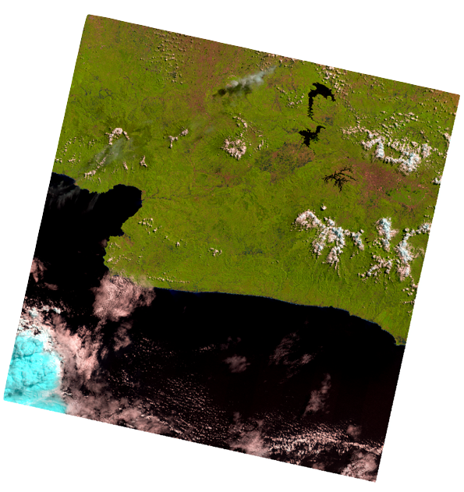
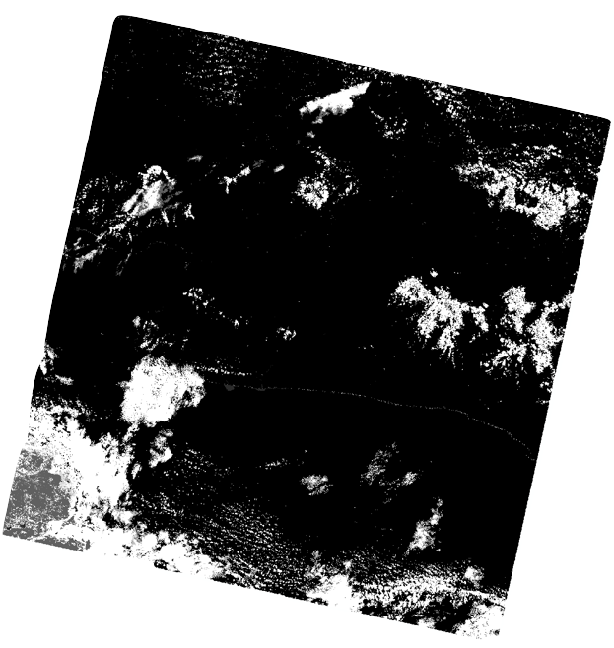
Cloud Masking
Band 654
Band BQA

Slide 3
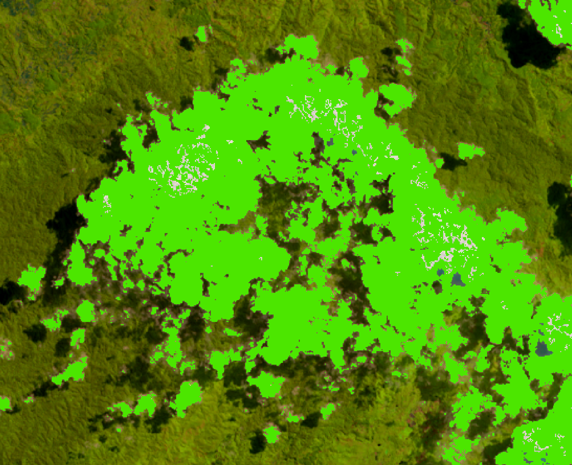
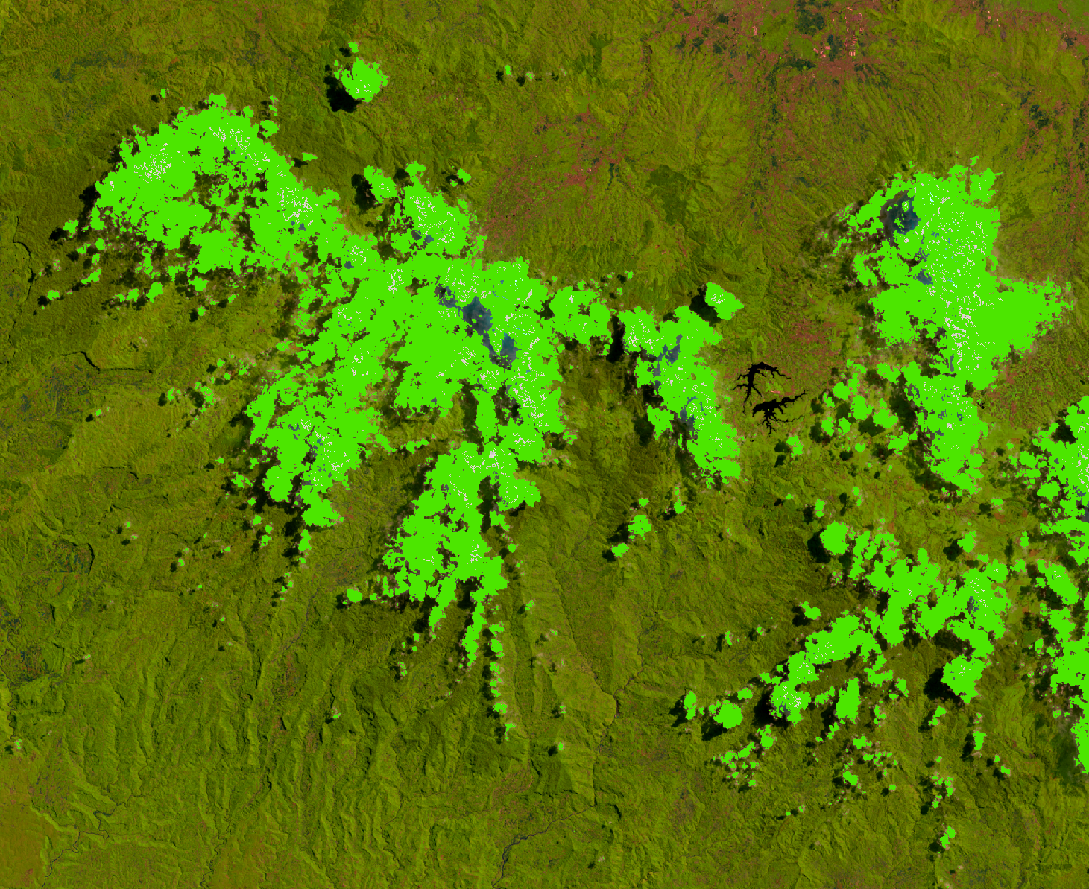

Slide 4
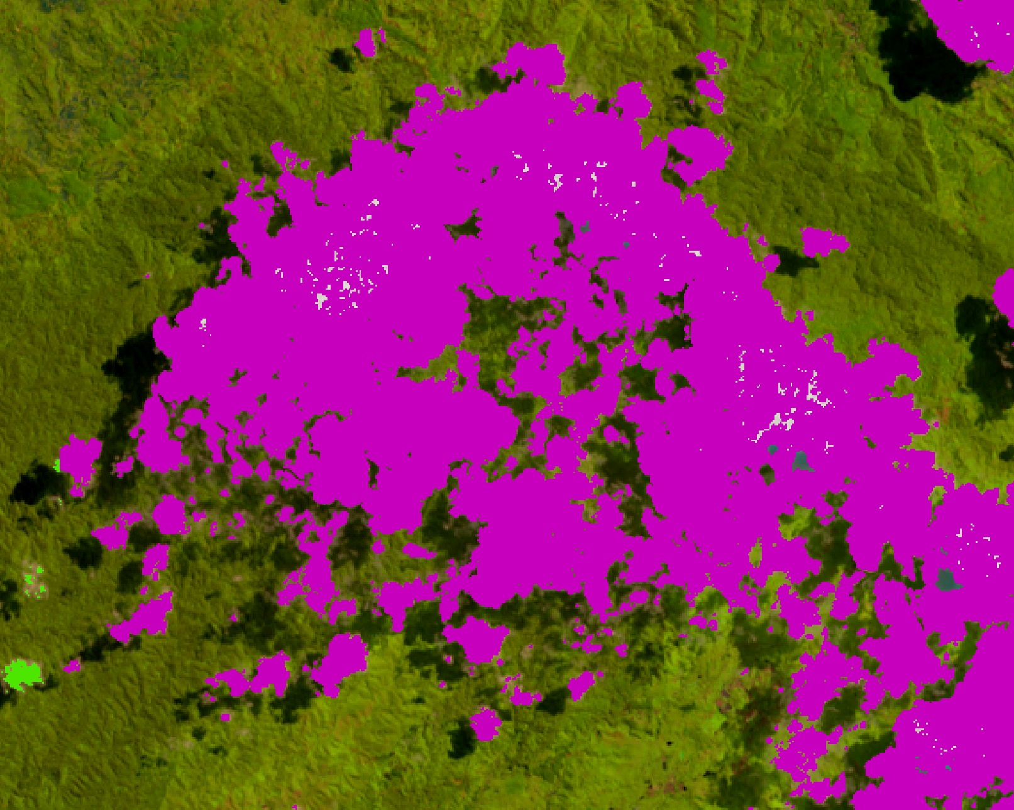
Buffering & Median filter
Original
Buffer 50

Slide 5
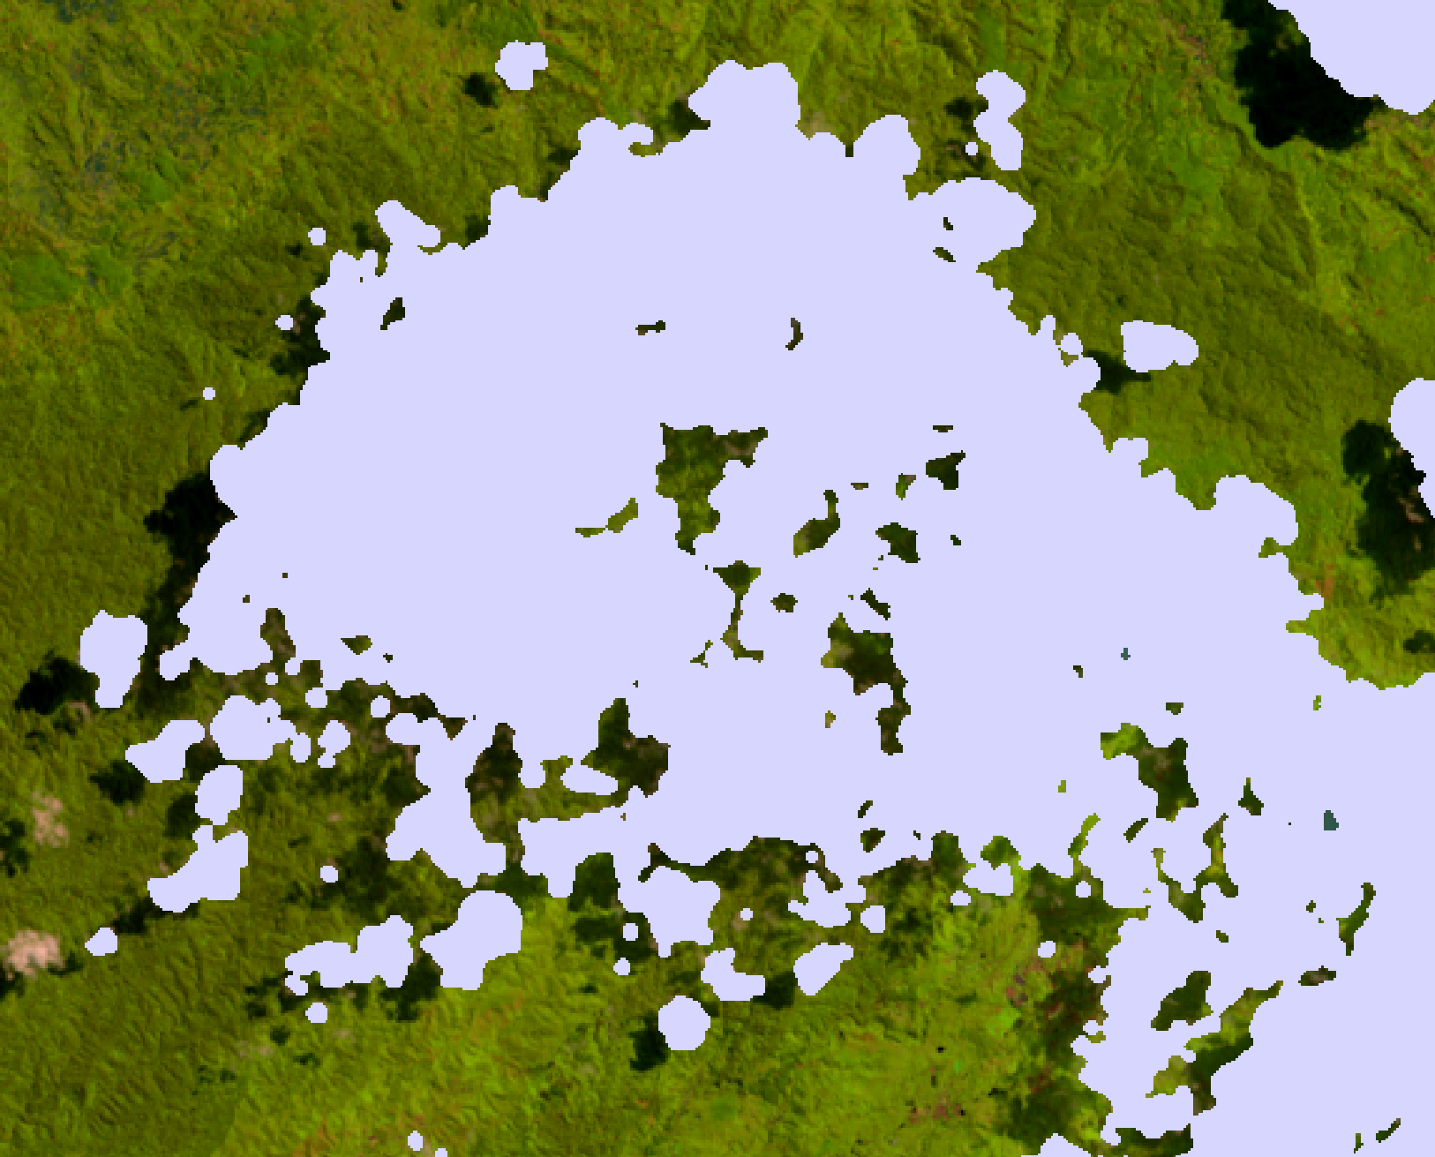
Buffering & Median filter
Buffer 50
Median Filter 3

Slide 6
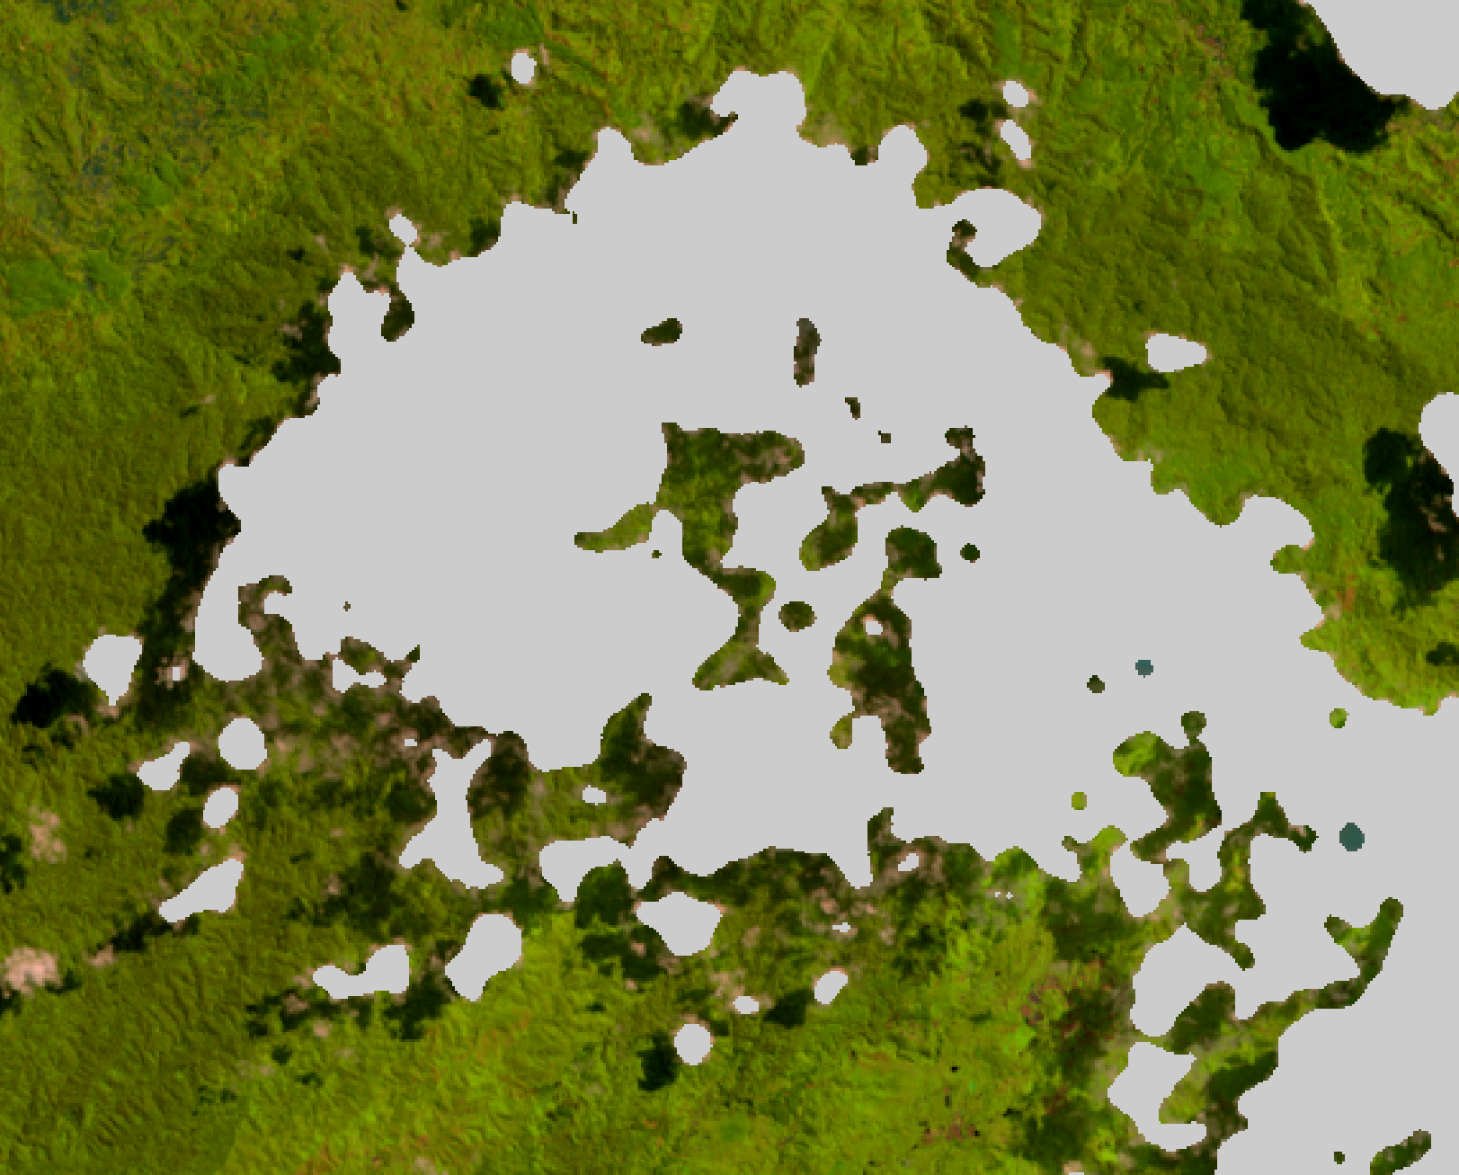
Buffering & Median filter
Median Filter 3
Median Filter 10

Slide 7
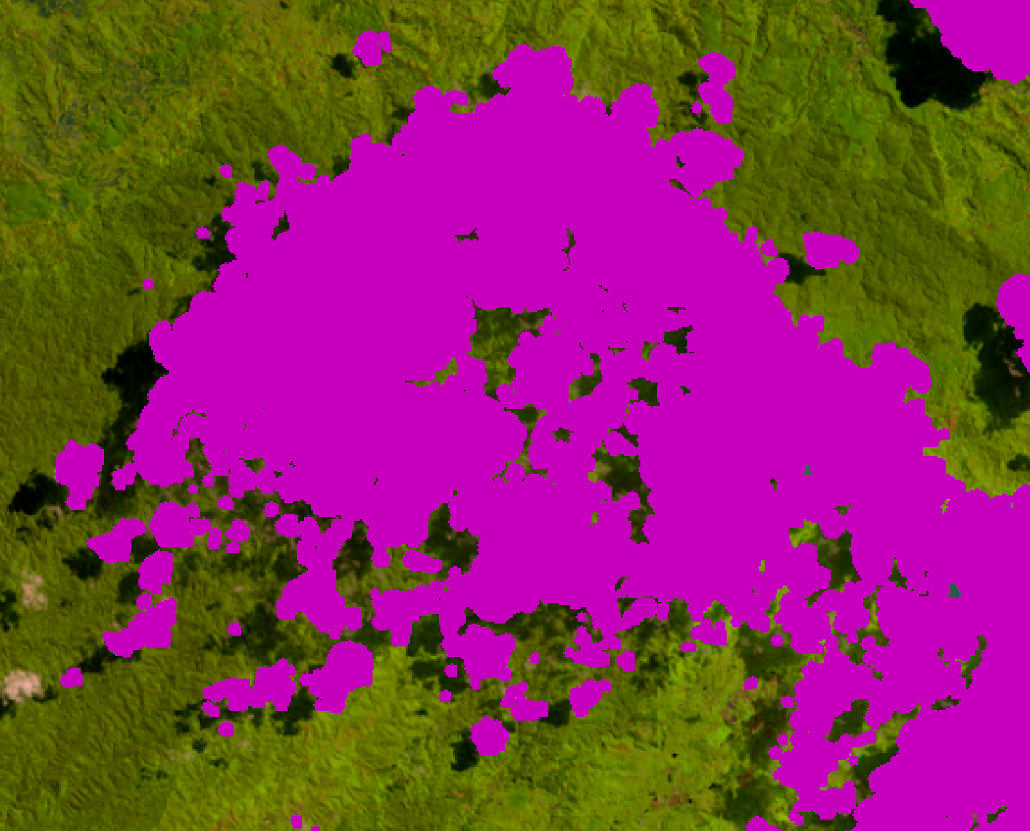
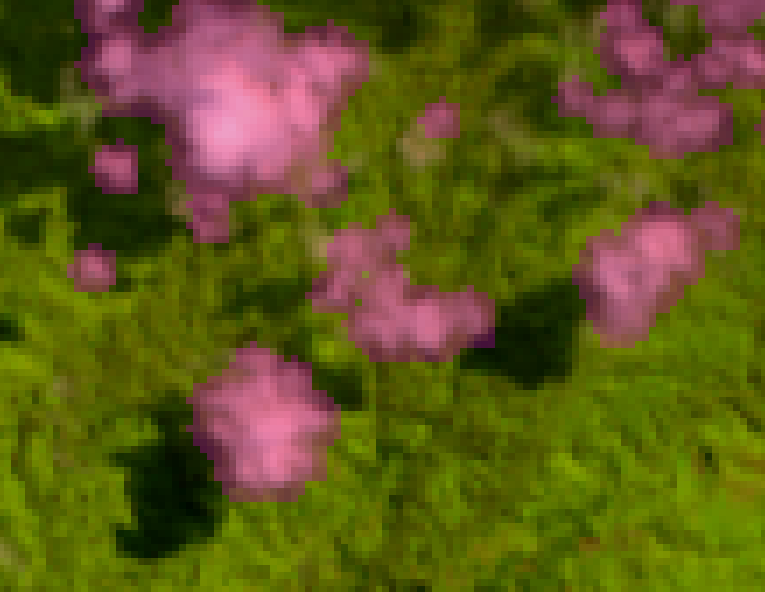
Buffering & Median filter
Original
Buffer 100

Slide 8
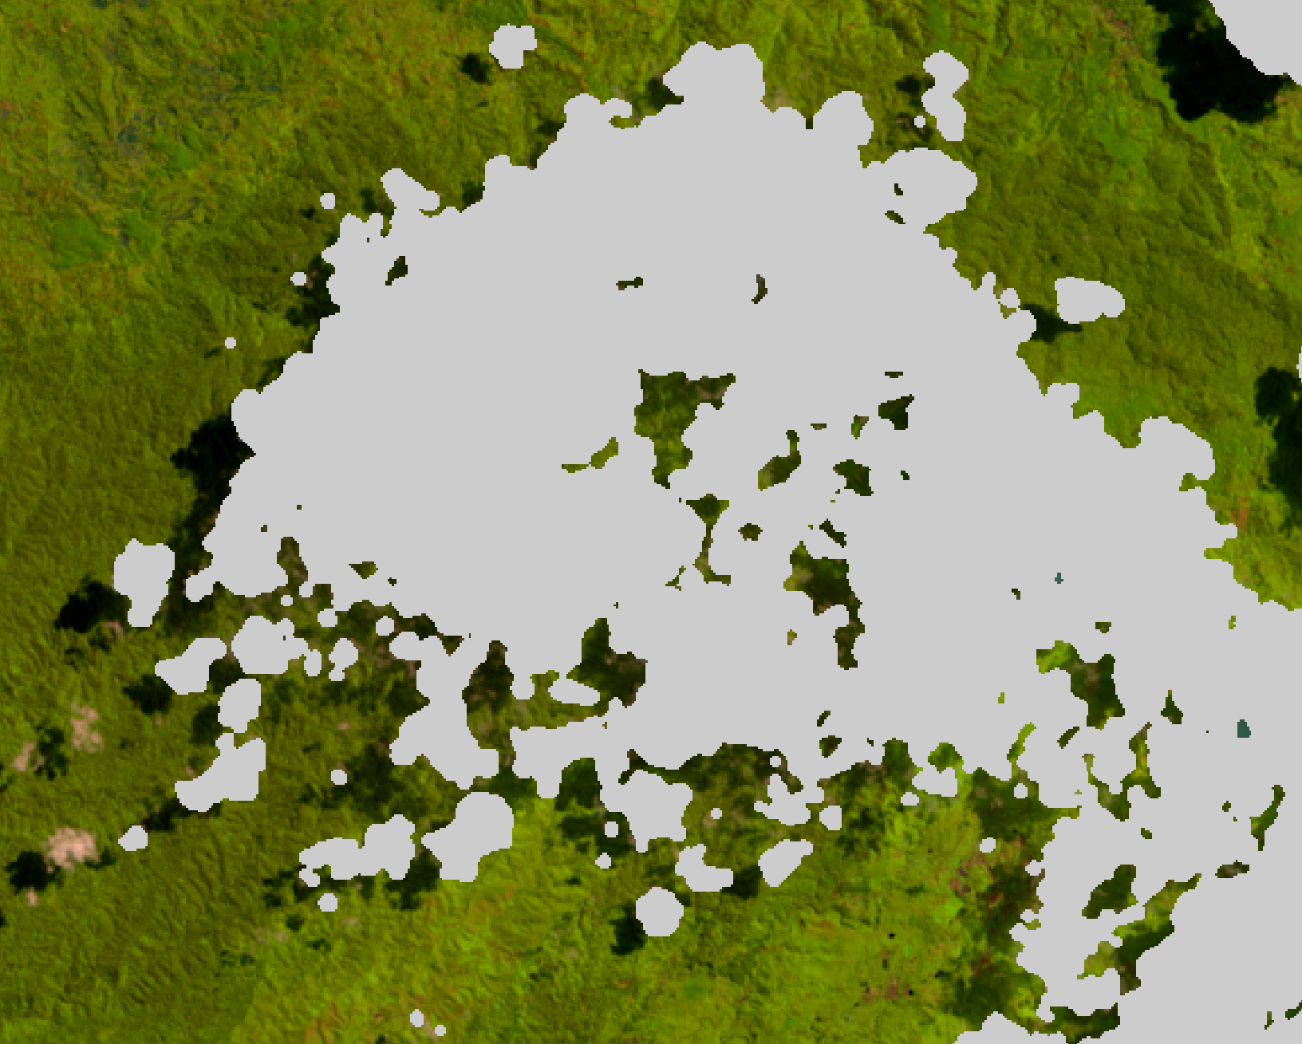
Buffering & Median filter
Buffer 100
Median Filter 3

Slide 9
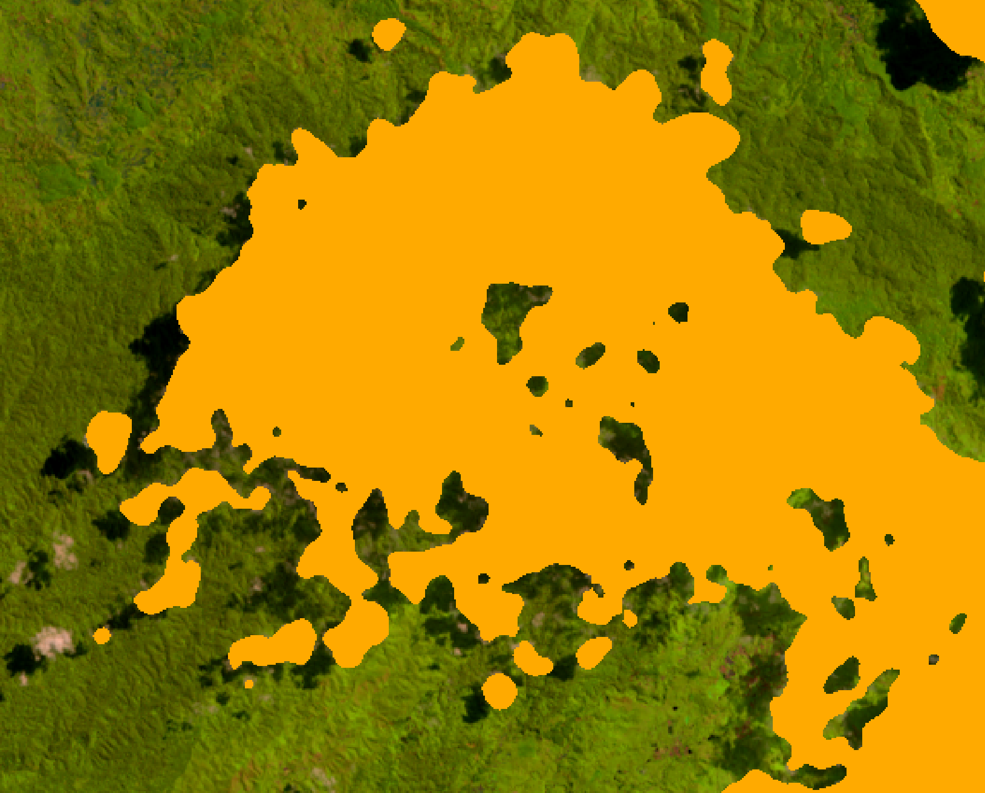
Buffering & Median filter
Median Filter 3
Median Filter 10

Slide 10
Buffering & Median filter
The proper thresholding in detection cloud are using buffer area 100 and median filter 3
Original
Buffer 100 & Median filter 3

Slide 11
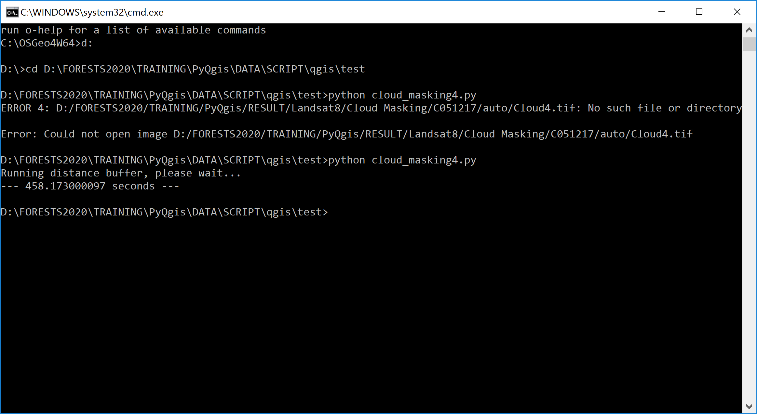
Running Time
Specification of Dell xps 13
Core i7 -7Y75 @1.30GHz
RAM 16GB

